Slide 1

Model Choice
Customization
RAG
Agents
Model Evaluation
Guardrails

Slide 2
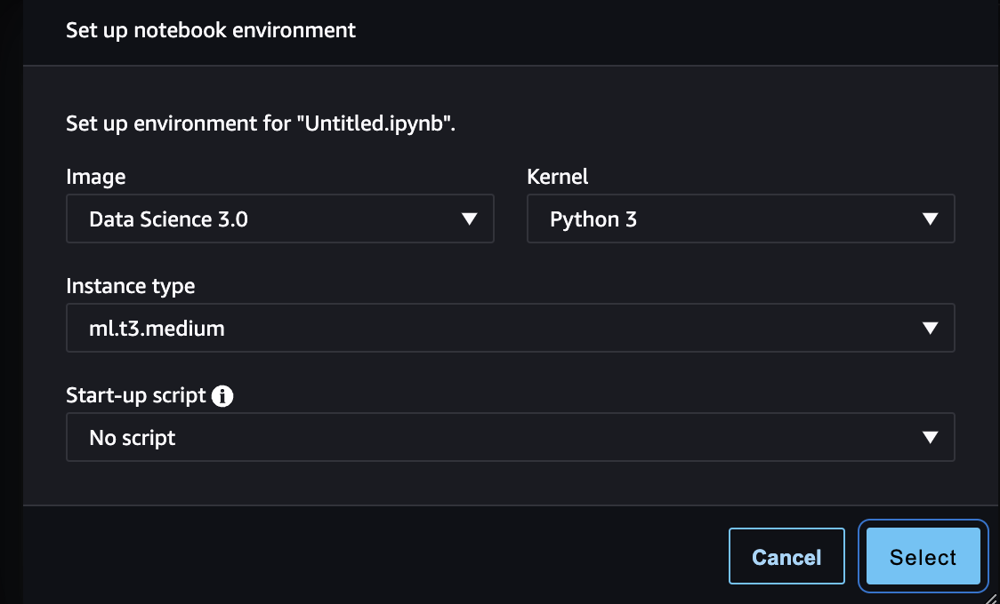

Slide 6
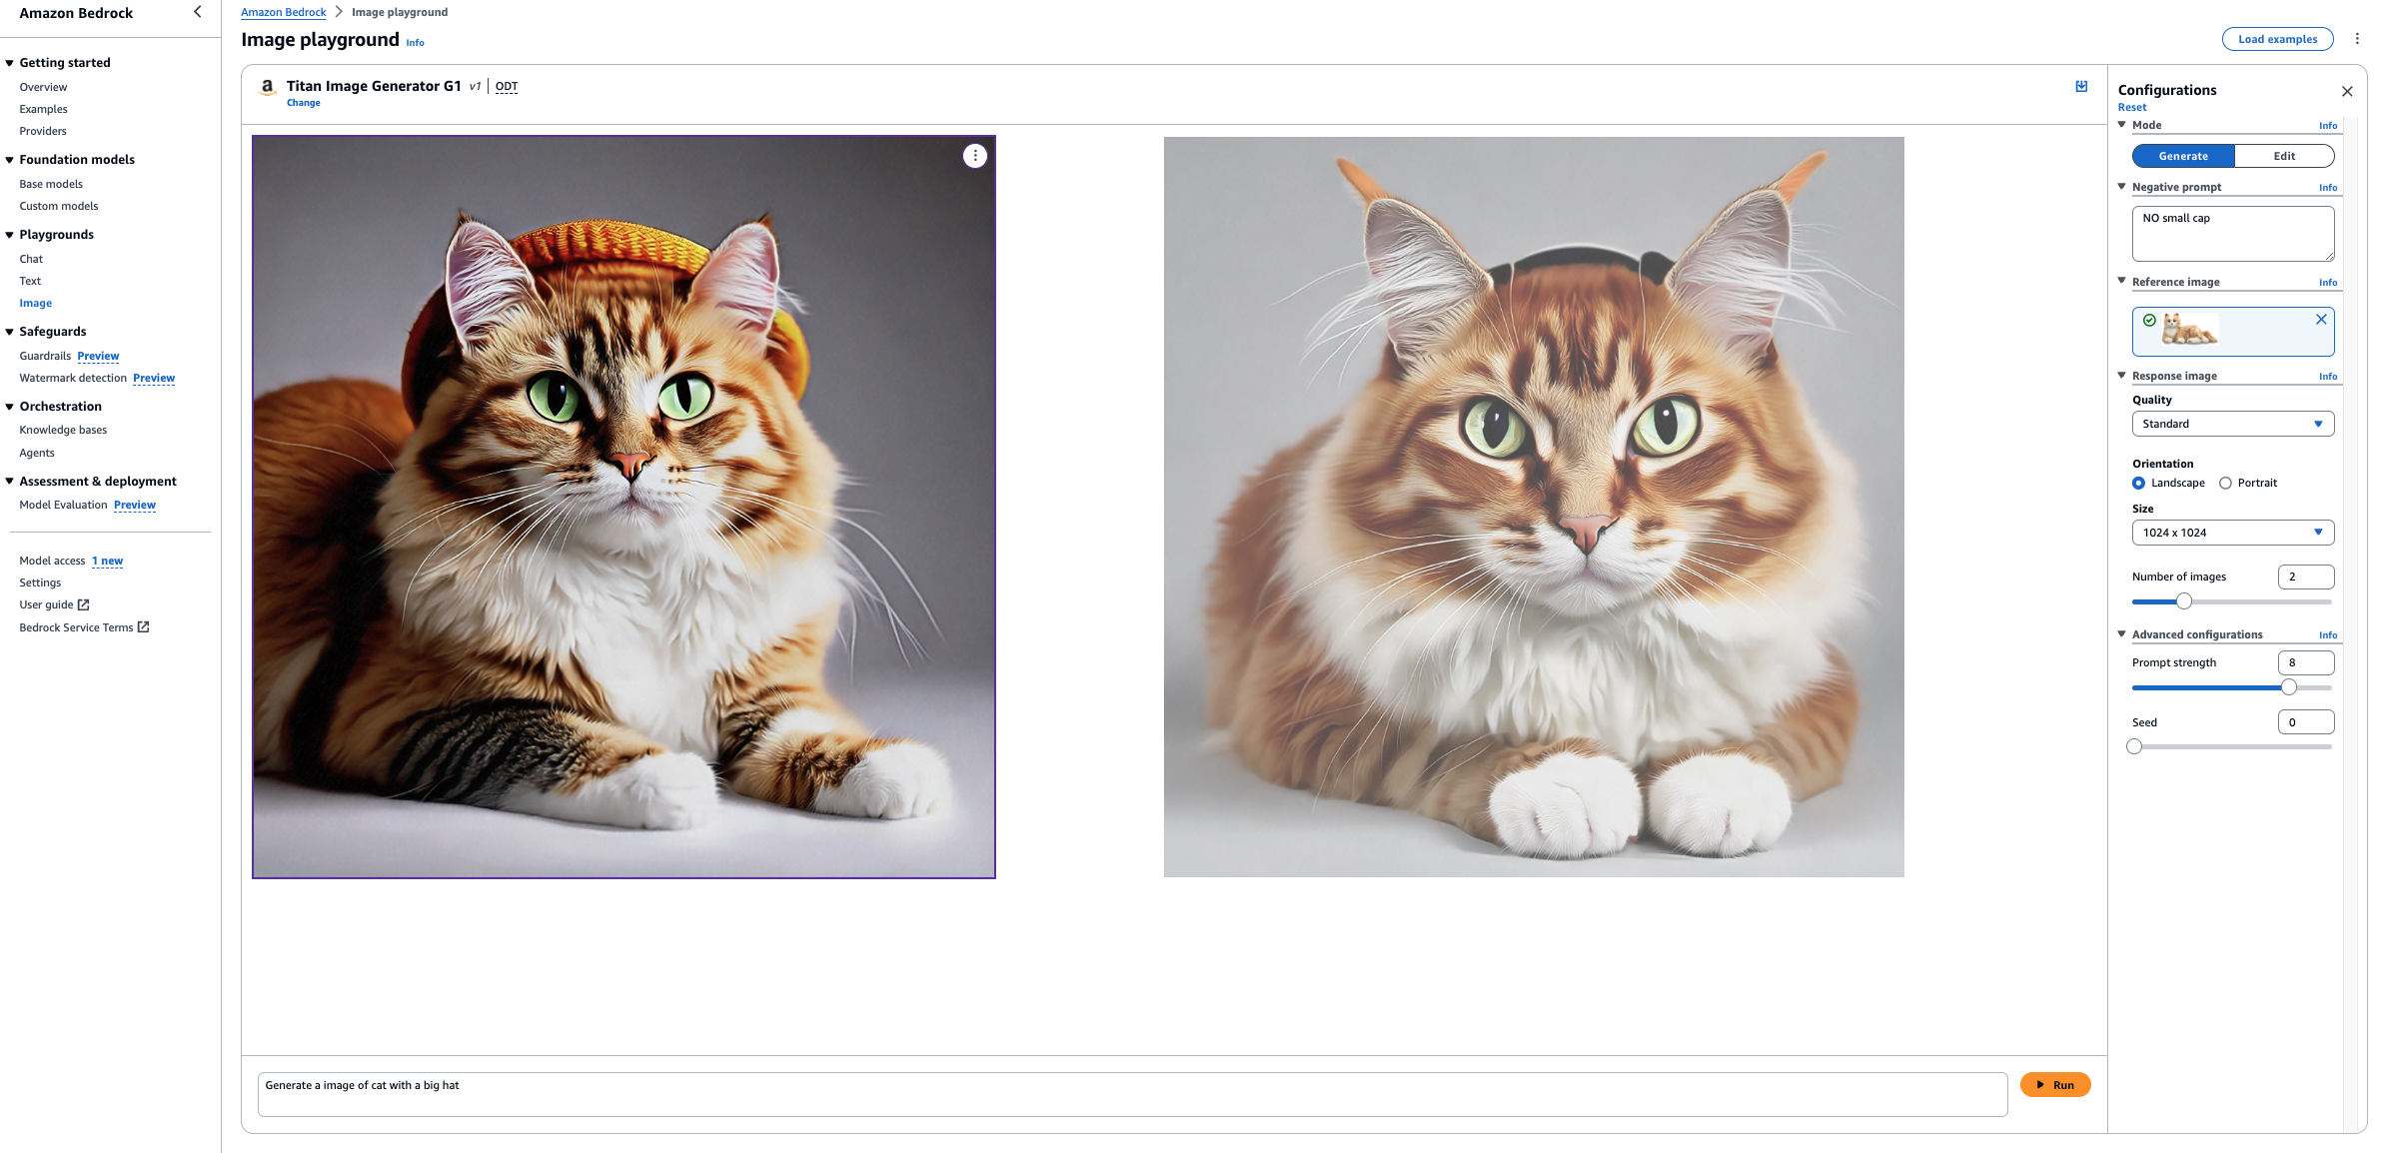

Slide 7
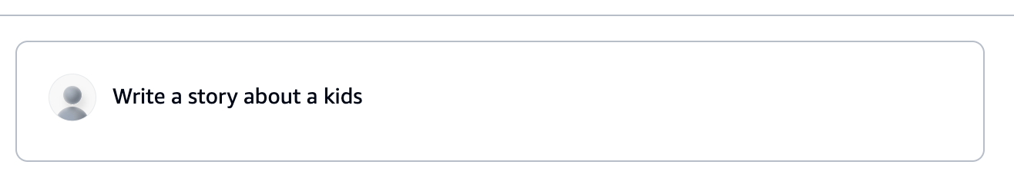
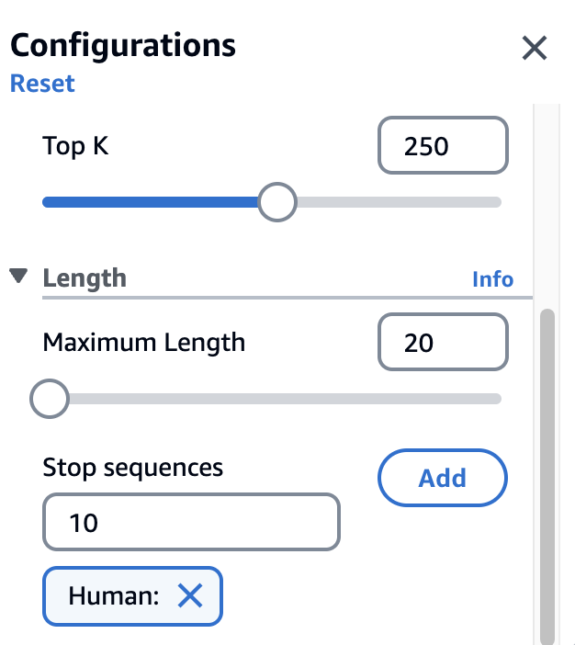
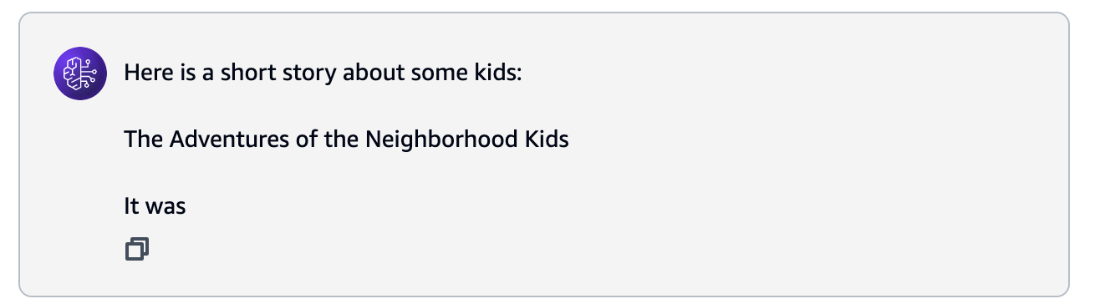

Slide 8
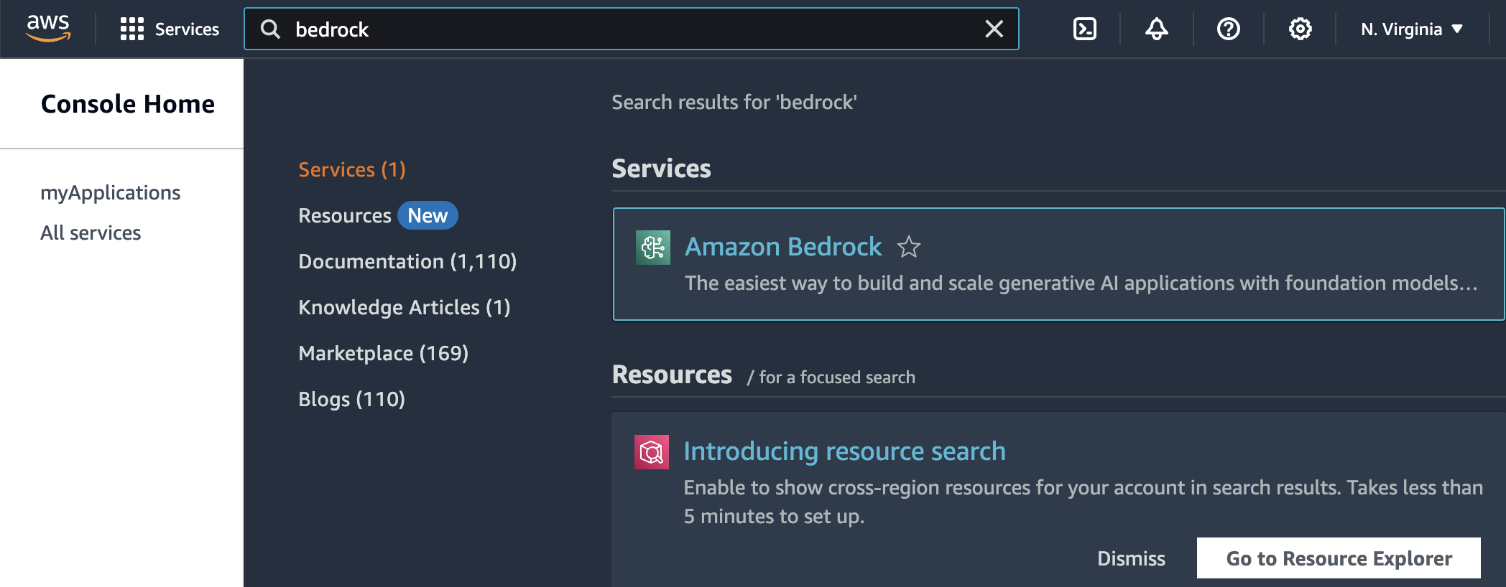

Slide 9
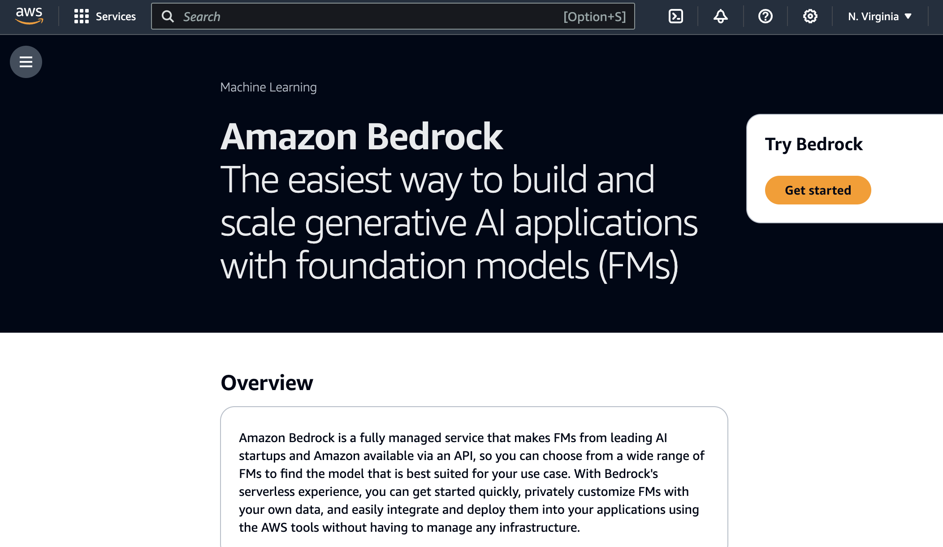

Slide 10
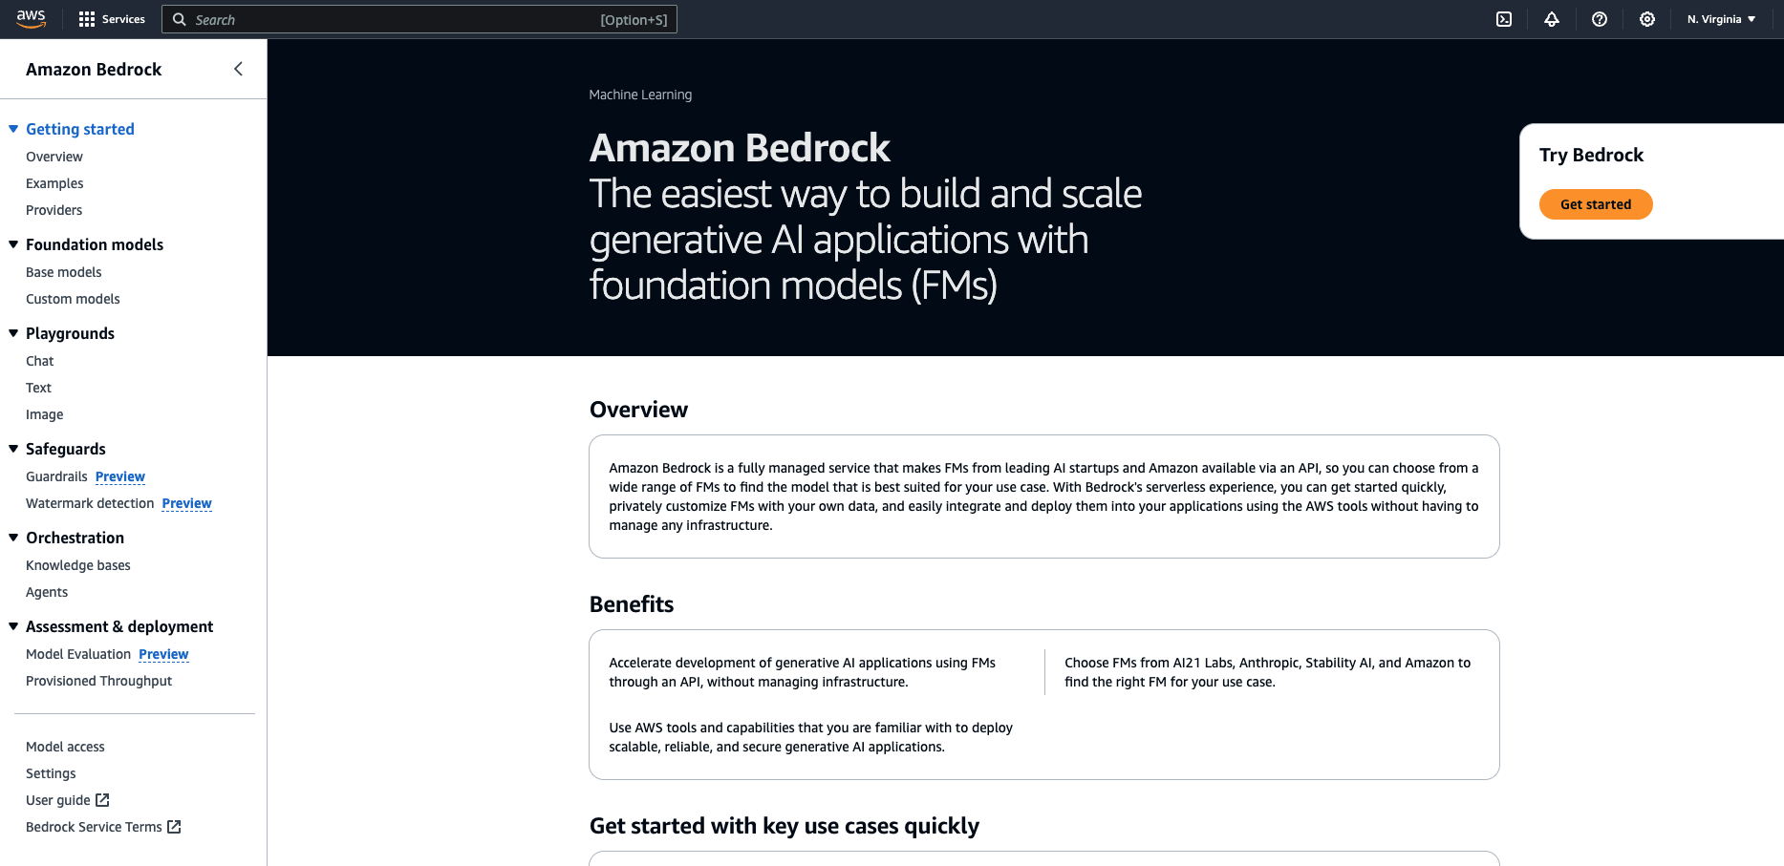

Slide 11
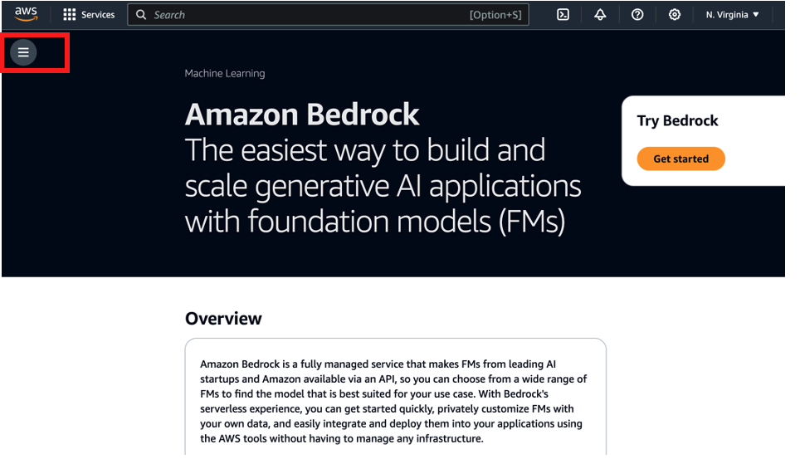

Slide 12
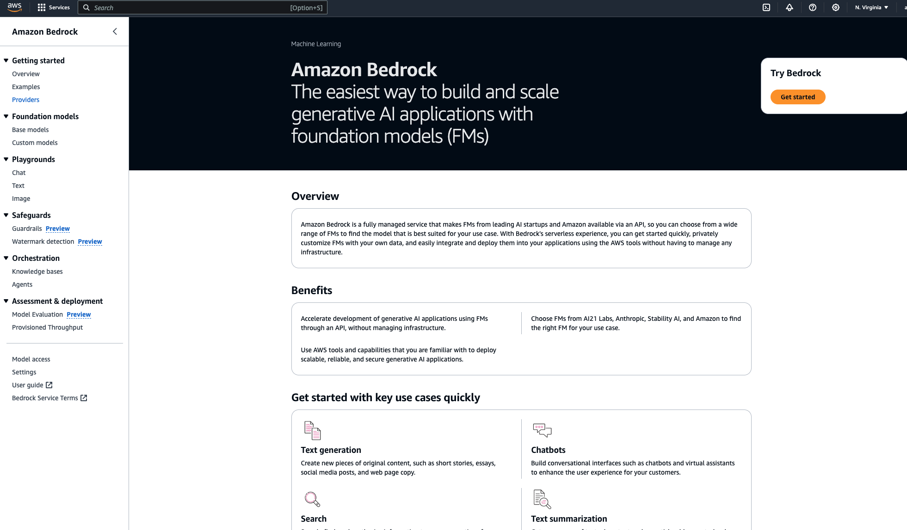









Slide 13


Slide 14
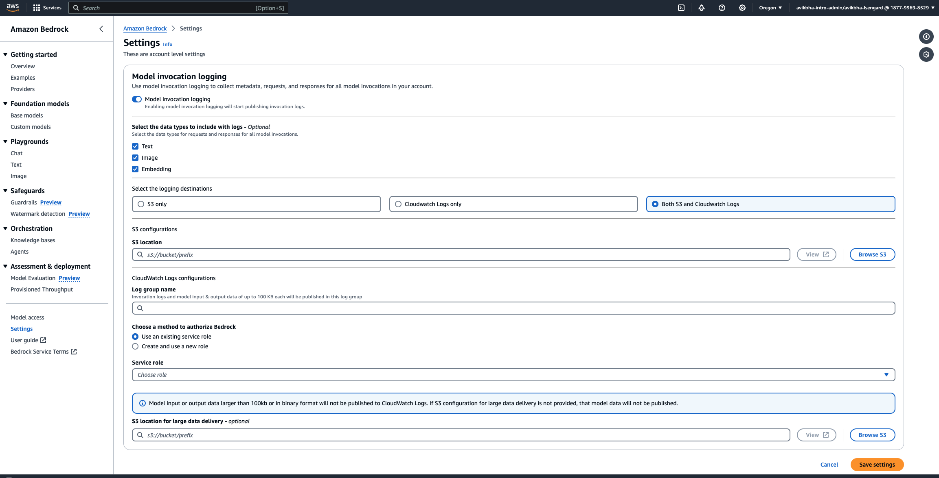

Slide 15
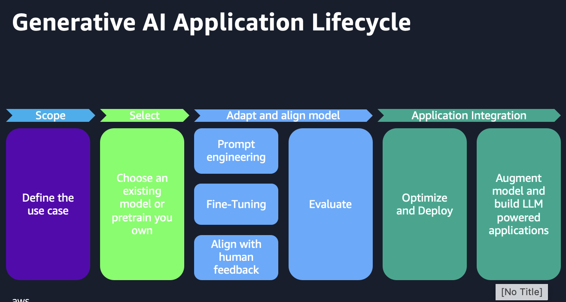
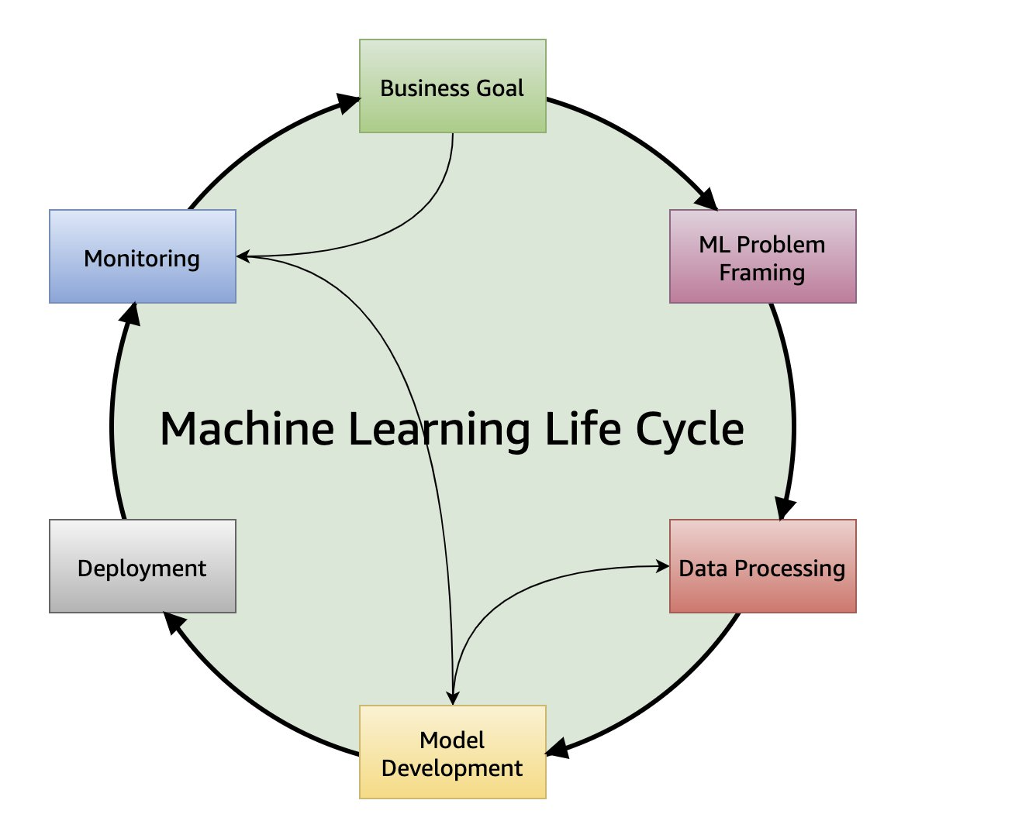

Slide 16
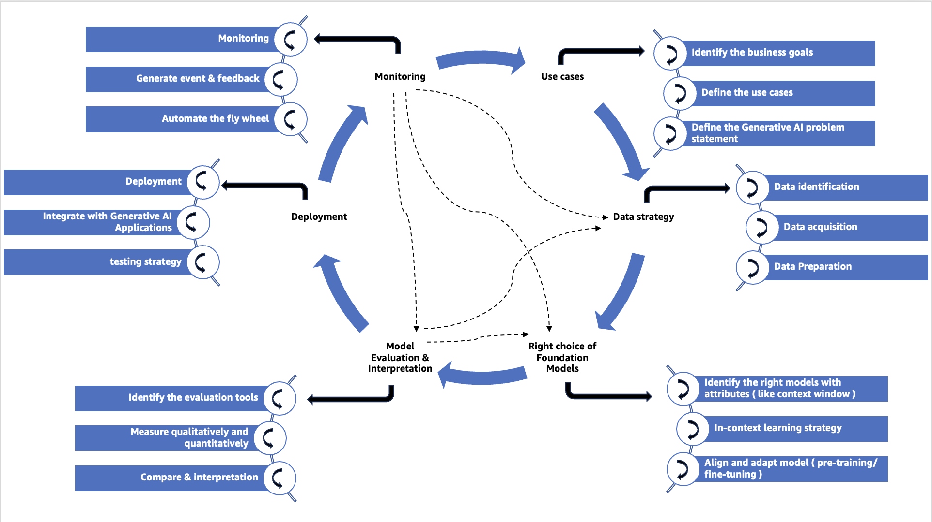
People
Process
Tools and Technologies

Slide 17
Monitoring
Generate event & feedback
Automate the fly wheel
Identify the business goals
Define the use cases
Define the Generative AI problem statement
Use cases
Data strategy
Right choice of Foundation Models
Deployment
Monitoring
Model Evaluation & Interpretation
Deployment
Integrate with Generative AI Applications
testing strategy
Data identification
Data acquisition
Data Preparation
Identify the evaluation tools
Measure qualitatively and quantitatively
Compare & interpretation
Identify the right models with attributes ( like context window )
In-context learning strategy
Align and adapt model ( pre-training/ fine-tuning )
Notes:
How managing use cases is important for Generative AI project lifecycle on the below points
Identify the business goals
Define the use cases
Define the Generative AI problem statement

Slide 18
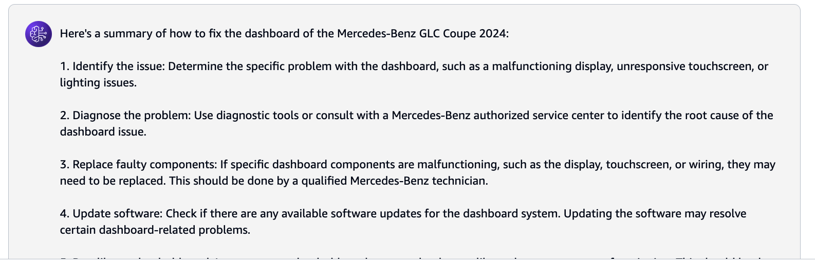
Prompt ( how to fix the dashboard of the Mercedes-Benz GLC Coupe 2024 )
Foundation Model
Response ( completion)

Slide 19
Prompt ( Text type)
Foundation Model ( Text-2-Text type )
Completion ( Text type)
Text based Prompts
Prompt ( Text type)
Foundation Model ( Text-2-Image type )
Completion ( Image type)
Image based Prompts
Prompt ( Text + Image or Video file etc)
Foundation Model ( Text-2-Text type )
Completion ( Image or Text type etc)
Multimodel Prompts

Slide 20
Instructions: Summarize the book review feedback
Role: Architect
Context: Technology Book
Review: recently had the pleasure of exploring this technology book, and I must say, I was thoroughly impressed. The variety and depth of chapters available are truly remarkable. In particular, I was delighted to discover some rare knowledge that I have been fervently searching for. This book that caught my attention was particularly relevant to my profession as a software architect. Its content provided valuable insights and perspectives that I found immensely beneficial for my work. However, I also noted that while the book was enriching for individuals in the software architect domain, it may appear somewhat convoluted for members of the developer community. Perhaps offering supplementary materials or resources to support a clearer understanding of complex concepts could enhance the accessibility of such content to a wider audience.
Negative Prompt: Developer Role
Summary:
Outcome from the Foundation Model:

Slide 21
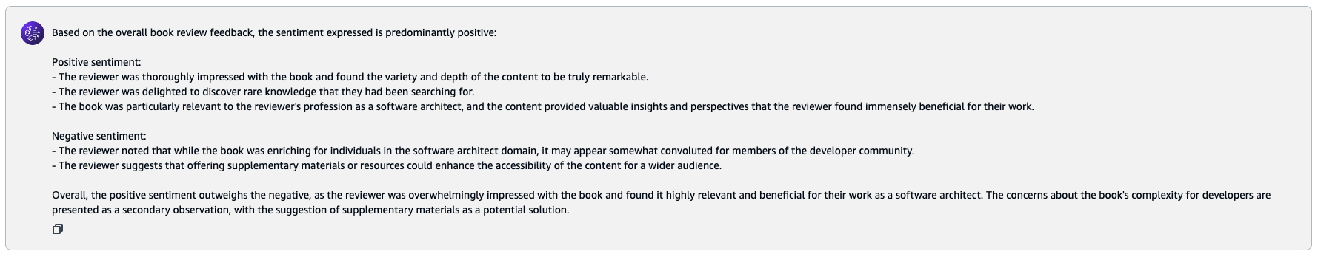
Instructions: generate sentiment the book review feedback
Context: Technology Book
Review: recently had the pleasure of exploring this technology book, and I must say, I was thoroughly impressed. The variety and depth of chapters available are truly remarkable. In particular, I was delighted to discover some rare knowledge that I have been fervently searching for. This book that caught my attention was particularly relevant to my profession as a software architect. Its content provided valuable insights and perspectives that I found immensely beneficial for my work. However, I also noted that while the book was enriching for individuals in the software architect domain, it may appear somewhat convoluted for members of the developer community. Perhaps offering supplementary materials or resources to support a clearer understanding of complex concepts could enhance the accessibility of such content to a wider audience.
sentiment:
Outcome from the Foundation Model:

Slide 22
System: Your task is to take the unstructured text provided and convert it into a well-organized table format using JSON. Identify the main entities, attributes, or categories mentioned in the text and use them as keys in the JSON object. Then, extract the relevant information from the text and populate the corresponding values in the JSON object. Ensure that the data is accurately represented and properly formatted within the JSON structure. The resulting JSON table should provide a clear, structured overview of the information presented in the original text.
User: Silvermist Hollow, a charming village, was home to an extraordinary group of individuals. Among them was Dr. Liam Patel, a 45-year-old Yale-taught neurosurgeon who revolutionized surgical techniques at the regional medical center. Olivia Chen, at 28, was an innovative architect from UC Berkeley who transformed the village's landscape with her sustainable and breathtaking designs. The local theatre was graced by the enchanting symphonies of Ethan Kovacs, a 72-year-old Juilliard-trained musician and composer. Isabella Torres, a self-taught chef with a passion for locally sourced ingredients, created a culinary sensation with her farm-to-table restaurant, which became a must-visit destination for food lovers. These remarkable individuals, each with their distinct talents, contributed to the vibrant tapestry of life in Silvermist Hollow.

Slide 23
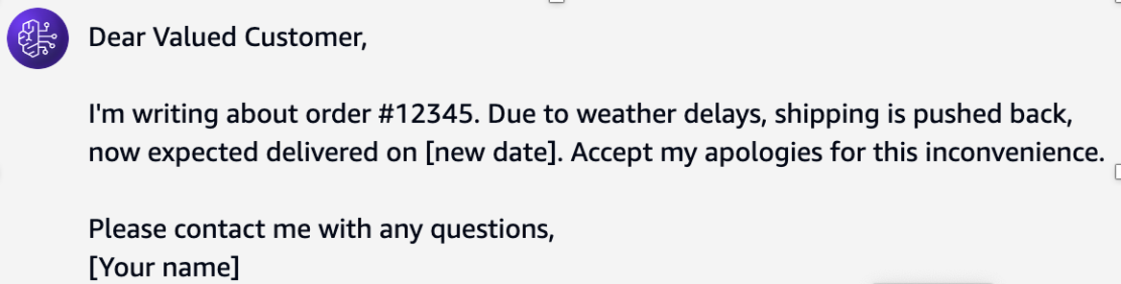
Agent: Write an email informing a customer of a delivery delay within 30 words

Slide 24
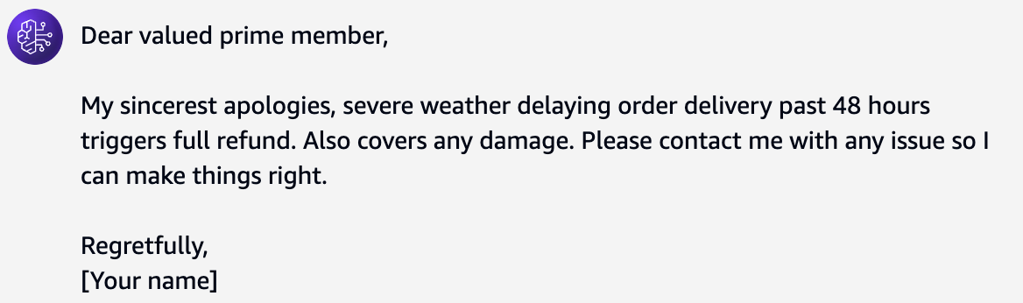
Agent: Compose an apologetic email to a customer regarding a shipping delay of a purchased product within 30 words. Include politeness and these details:
Severe weather affected the transportation.
If the delay exceeds 48 hours, offer a full refund.
If the product gets damaged, provide a full refund.
This customer has prime purchase status.

Slide 25
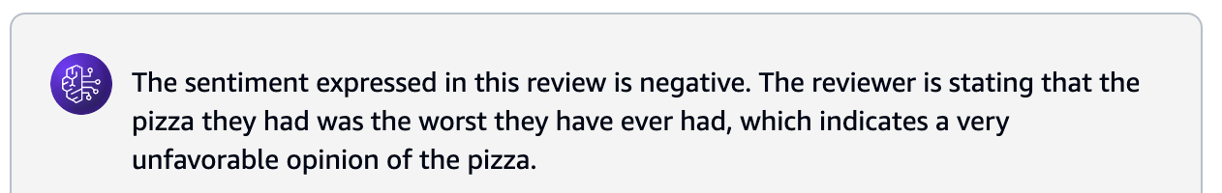
Review: This pizza is the worst I've ever had.
Sentiment:

Slide 26
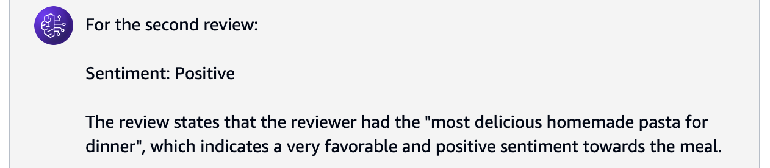
Review: This pizza is the worst I've ever had.
Sentiment: Negative
Review: Just had the most delicious homemade pasta for dinner.
Sentiment:

Slide 27
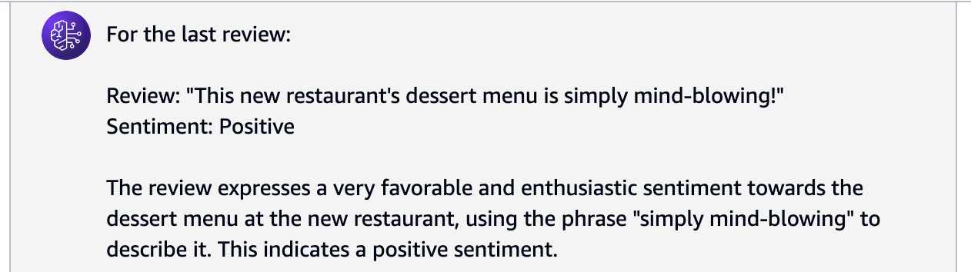
Review: This pizza is the worst I've ever had.
Sentiment: Negative
Review: Just had the most delicious homemade pasta for dinner.
Sentiment: Positive
Review: I'll send you the recipe for that amazing chocolate cake.
Sentiment: Neutral
Review: This new restaurant's dessert menu is simply mind-blowing!
Sentiment:

Slide 28
On a given week during Xmas, the footfall of visitors of a famous city mall were Monday: 20000 visitors Tuesday: 21000 visitors Wednesday: 22000 visitors There is trend that same average visitors footfall during the weekend.
Question: How many visitors can we expect on Friday?
Answer: Based on the numbers given and without any more information, there is a daily decrease of 1000 visitors. If we assume this trend will continue during the following days, we can expect 22000 visitors on the next day that would be Thursday, and therefore 23000 visitors on the next day that would be Friday.
Question: How many visitors can we expect on Saturday and Sunday? (Think Step-by-Step)
Answer:

Slide 29
Okay, let's think through the answer to the second question step-by-step:
Question: How many visitors can we expect on Saturday and Sunday?
Step 1: Analyse the given information
- The visitor footfall on Monday was 20,000
- The visitor footfall on Tuesday was 21,000
- The visitor footfall on Wednesday was 22,000
- There is a trend of the same average visitor footfall during the weekend
Step 2: Determine the expected visitor footfall on Thursday and Friday
- The answer states that based on the daily decrease of 1,000 visitors, the expected visitor footfall on Thursday would be 22,000 and on Friday would be 23,000.
Step 3: Estimate the expected visitor footfall on Saturday and Sunday
- Since the question states that there is a trend of the same average visitor footfall during the weekend, we can assume that the average of the weekday visitor footfall would apply to the weekend as well.
- The average of the weekday visitor footfall is (20,000 + 21,000 + 22,000 + 23,000) / 4 = 21,500 visitors.
Step 4: Conclude the expected visitor footfall on Saturday and Sunday
- Based on the assumption of the same average visitor footfall during the weekend, we can expect 21,500 visitors on both Saturday and Sunday.
In summary, the answer is:
Saturday: 21,500 visitors
Sunday: 21,500 visitors
The key assumption made is that the trend of the same average visitor footfall during the weekend holds true.

Slide 30
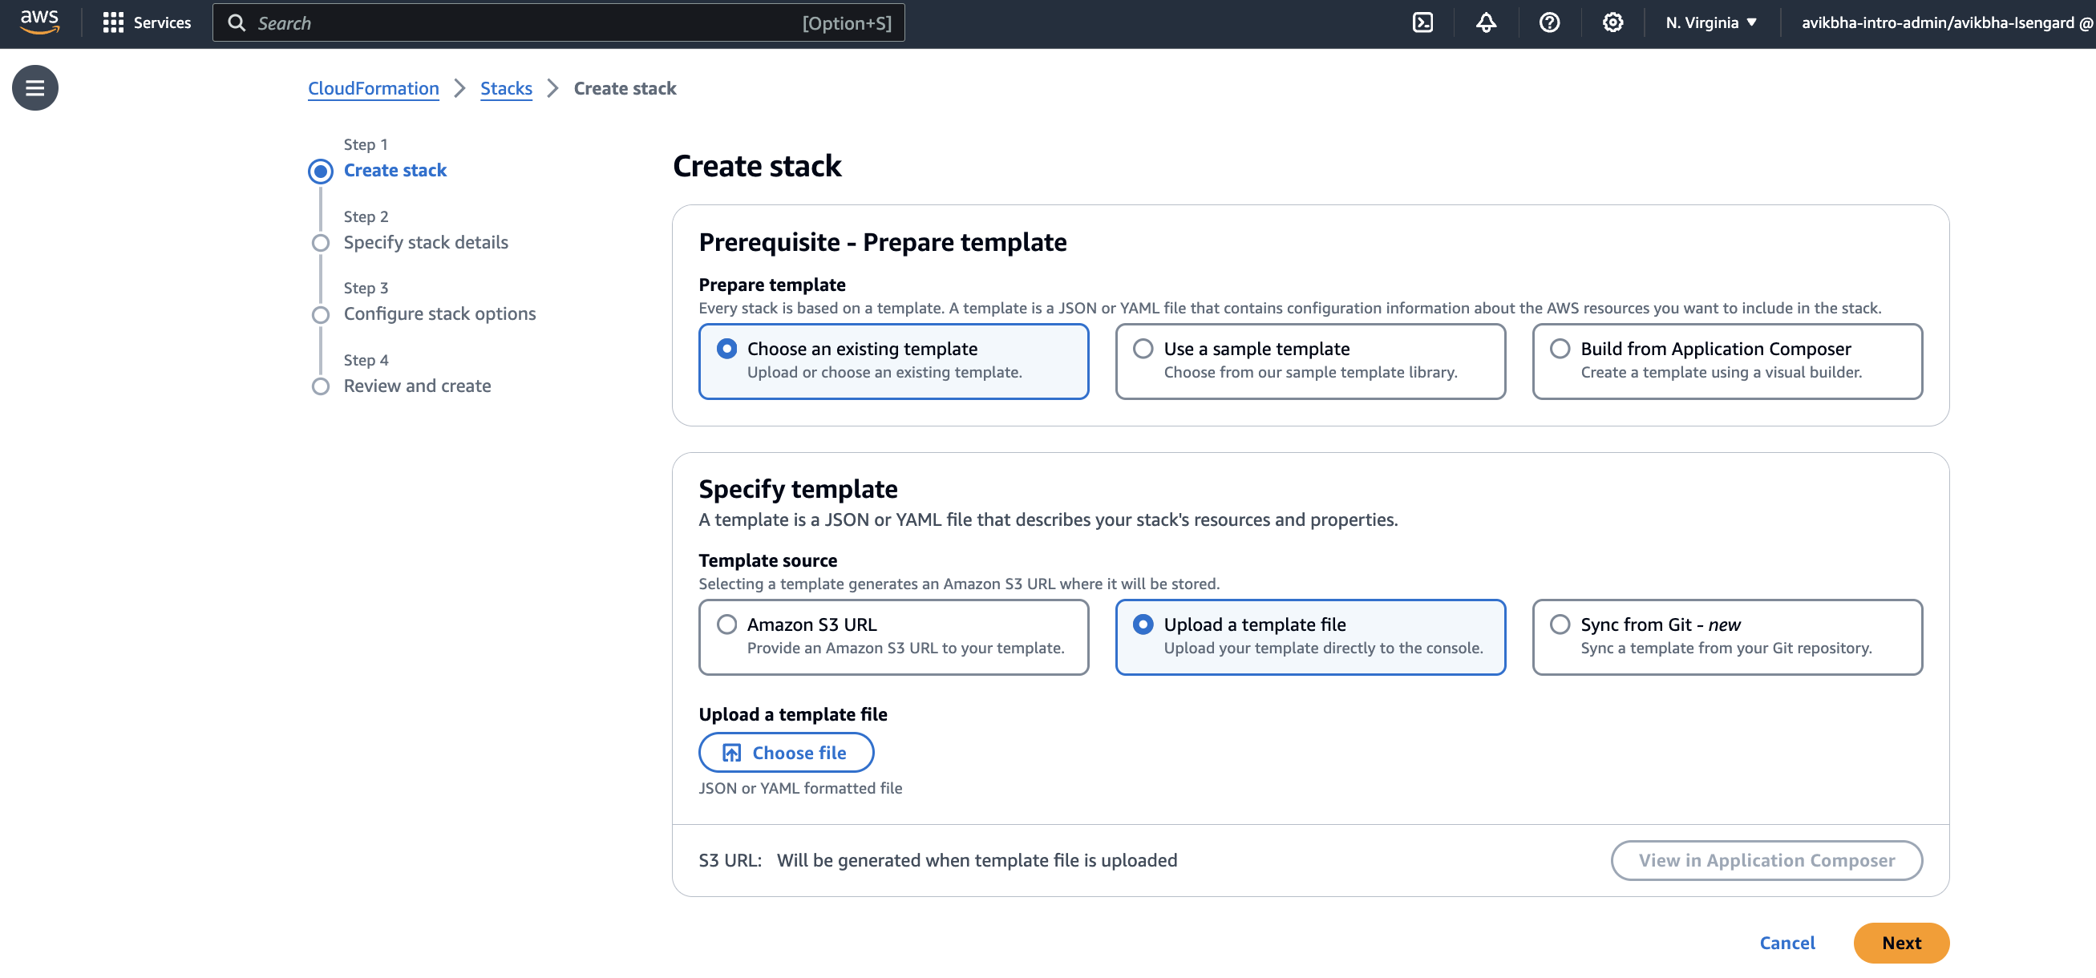

Slide 31
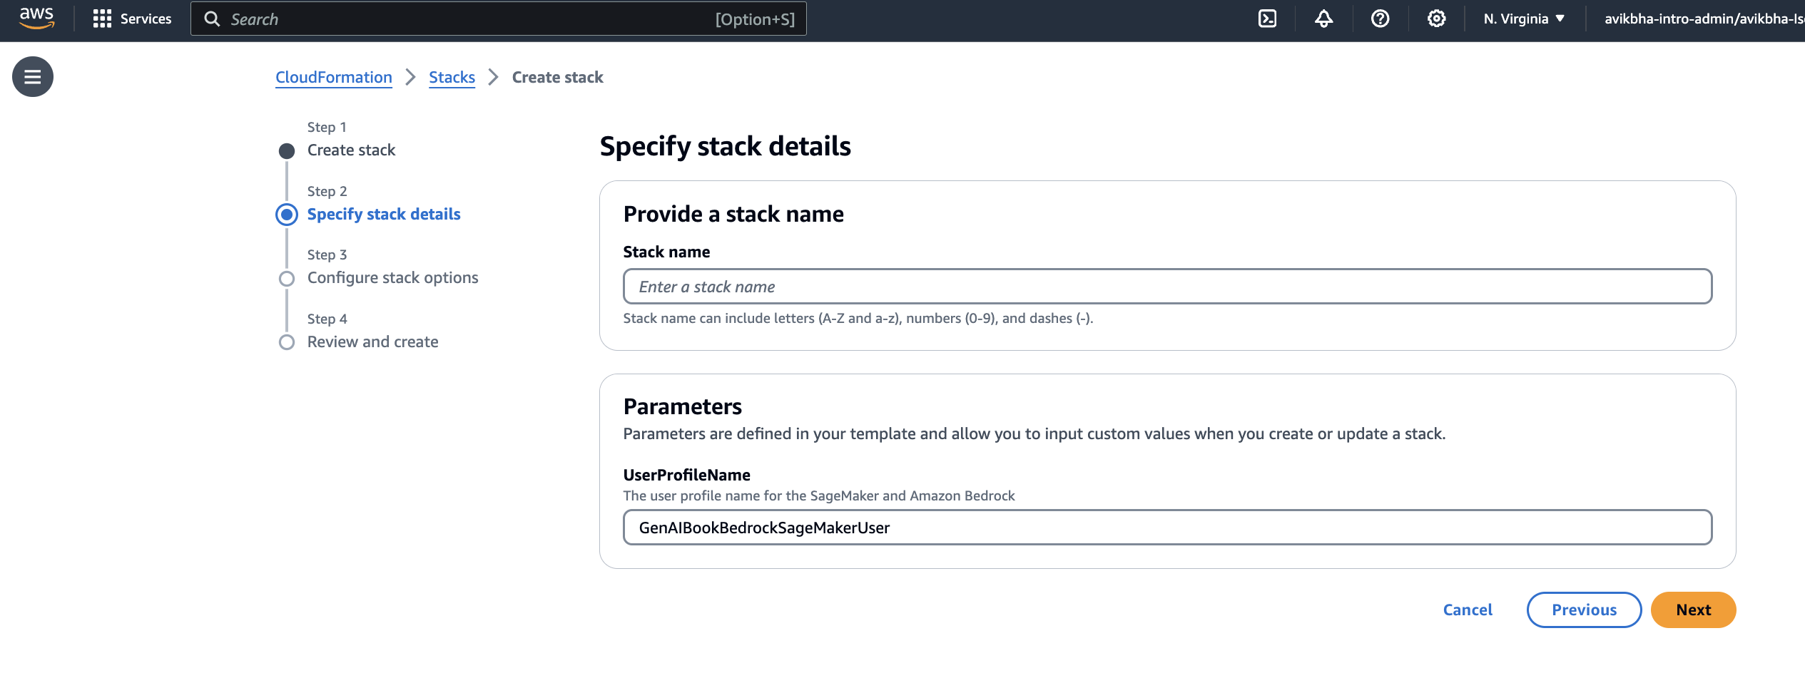

Slide 32
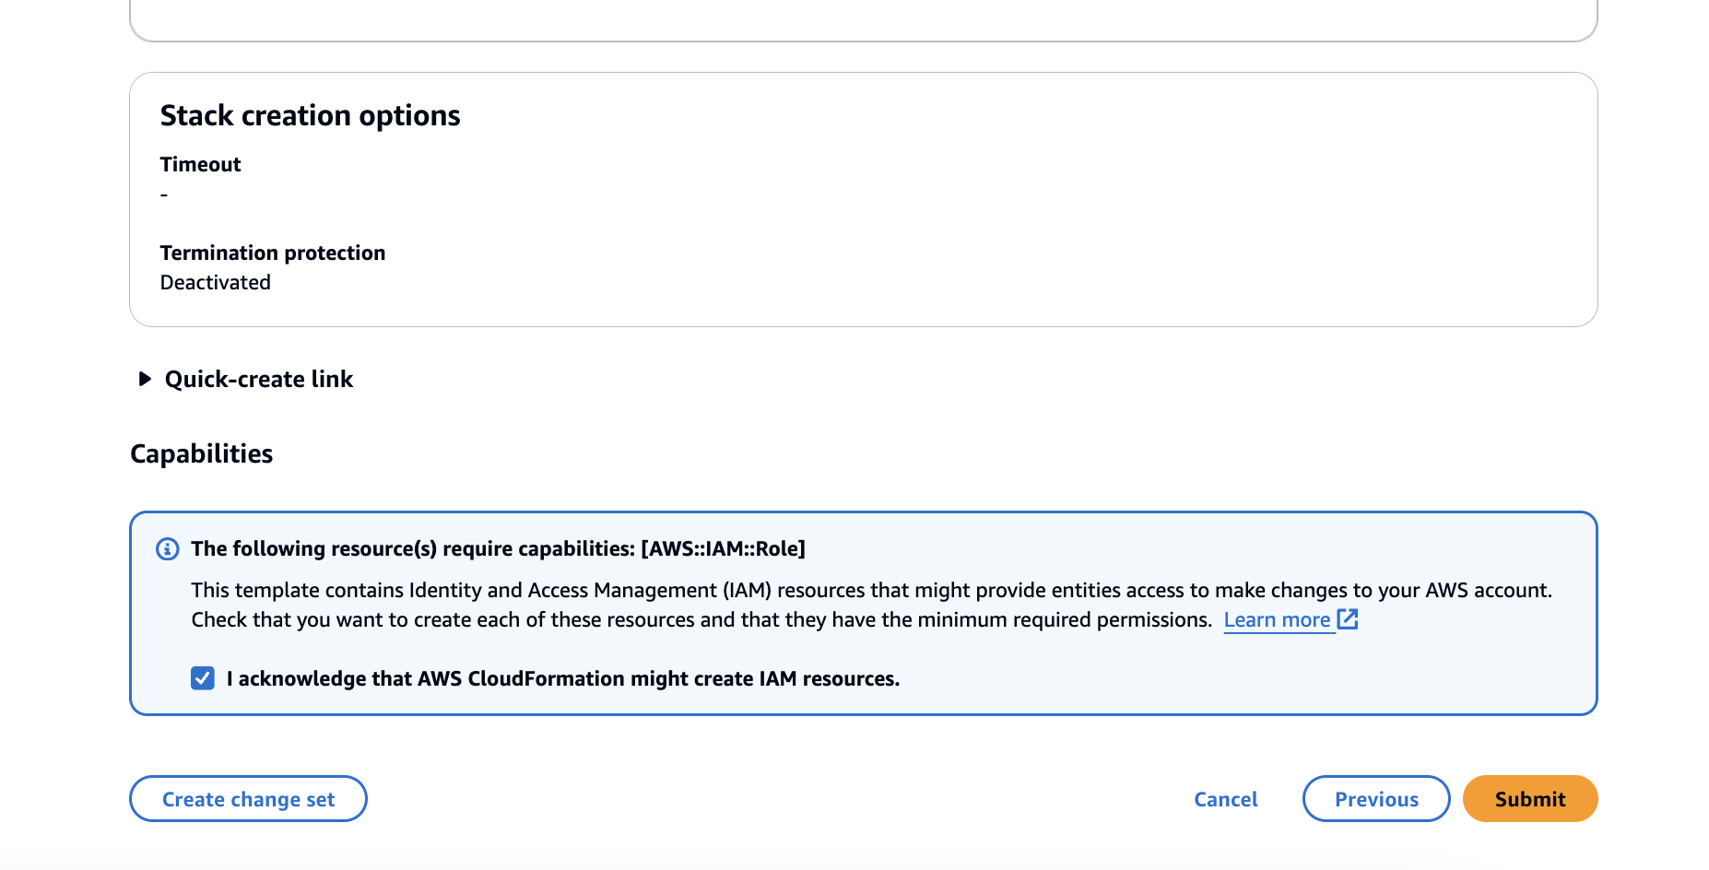

Slide 33
Prompt ( how to fix the dashboard of the Mercedes-Benz GLC Coupe 2024 )
Response without exact context or hallucinated response
LLM model
Very generic response ( completion)

Slide 34
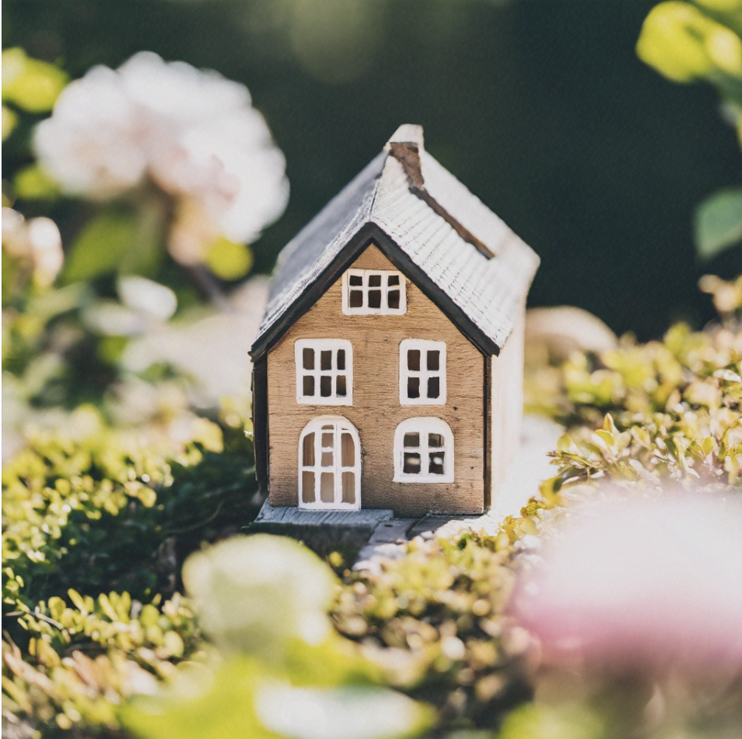
Size=2000
Bedrooms = 3
Latitude = 34.0522
longitude = −118.2437

Slide 35
bad | 1 | 0 | 0
worse | 0 | 1 | 0
worst | 0 | 0 | 1
bad | [ 0.2 , 0.8 ]
worse | [ 0.5 , 0.6 ]
worst | [ 0.9 , 0.7 ]

Slide 36
Tokyo and Kyoto with their similar latitude, longitude coordinates, and population densities information
Embedding API
[ 0.259 , 0.359 , …..]

Slide 37












Retrieval Process
Embedded output and searching
Searching
Embedding Model
Apps
Embedded output and retrieval
Retrieval
Document Reader & Text Chunk Conversion
Embedding Model
Embedded output and indexing
Indexing
Offline / Adhoc data collection

Slide 38

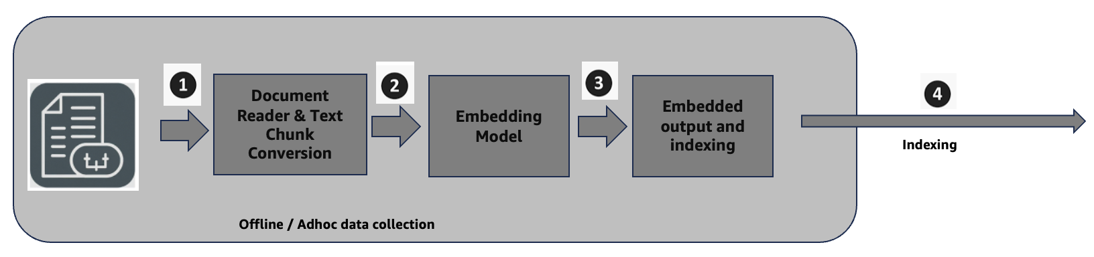
Retrieval Process
Embedded output and searching
( Query
+ Prompt )
( Query )
Searching
Gen AI Rag Application
Embedding Model
Apps
Enhanced context
Embedded output and retrieval
Retrieval
Generated response
( Query
+ Prompt +
Enhanced context
)
Knowledge Base
( Vector database)

Slide 40
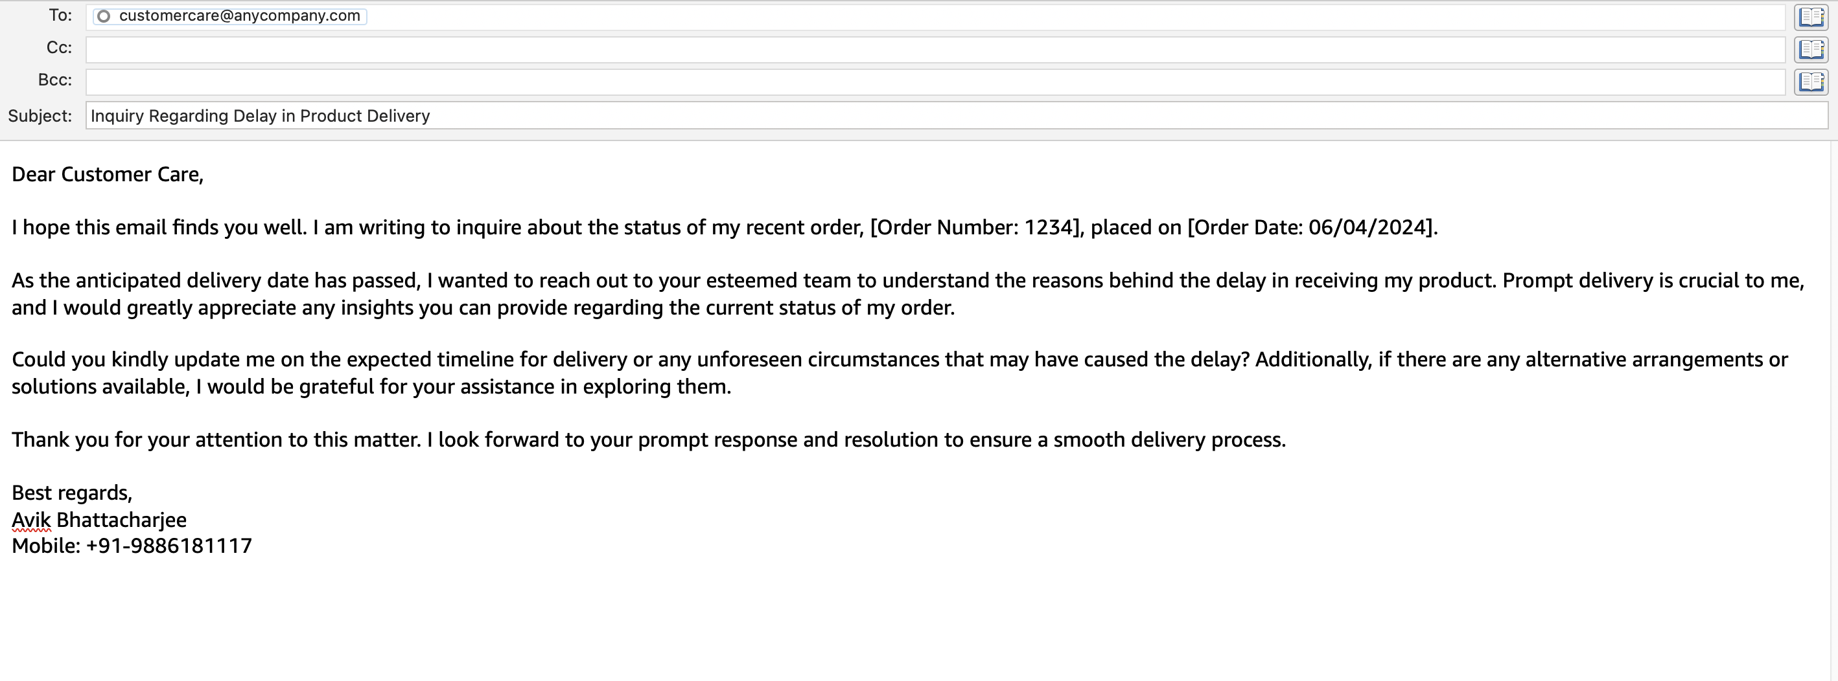

Slide 41
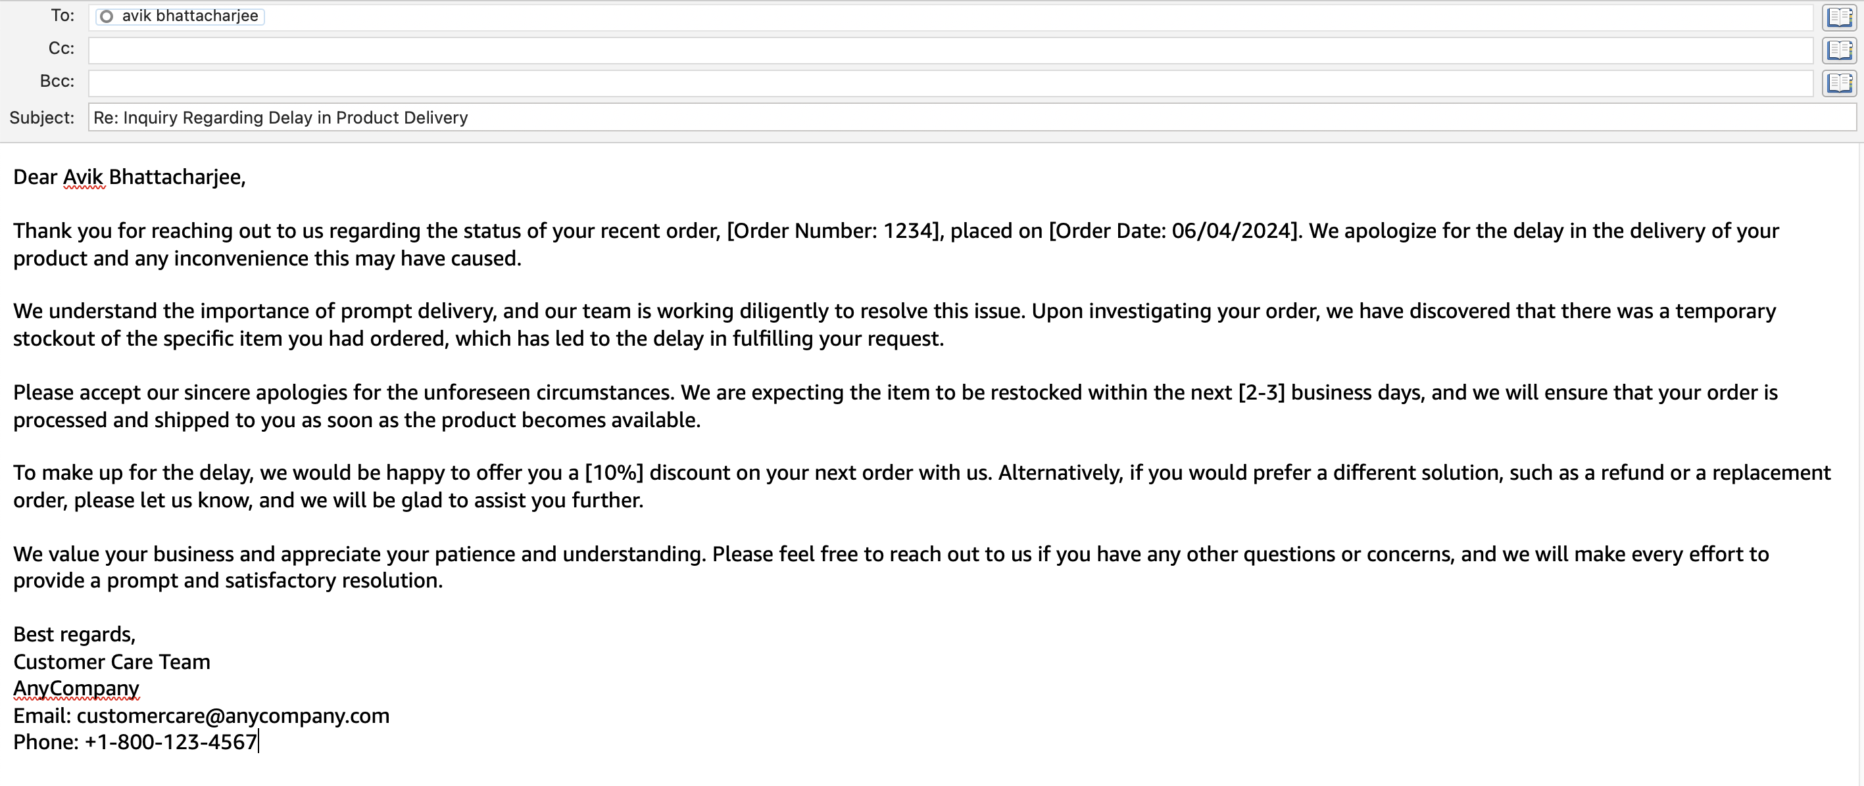

Slide 42
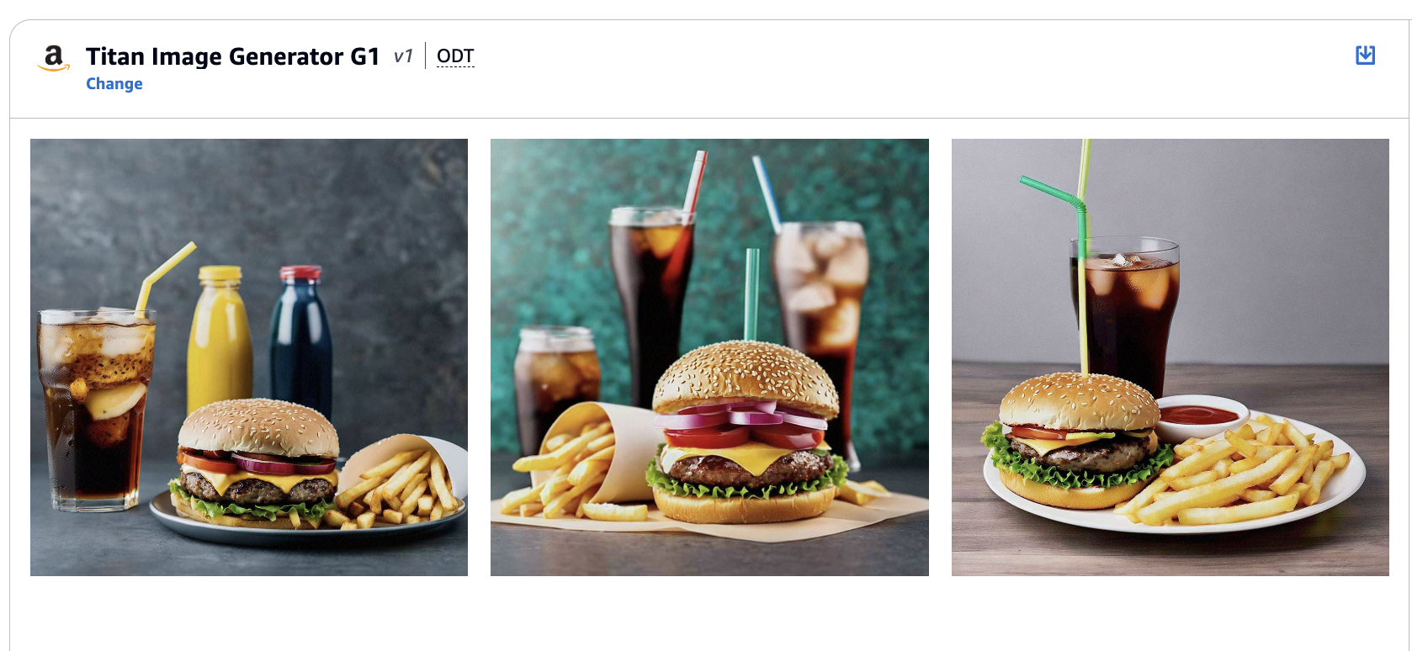

Slide 43
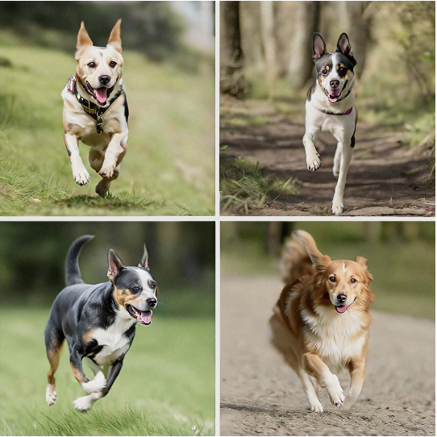
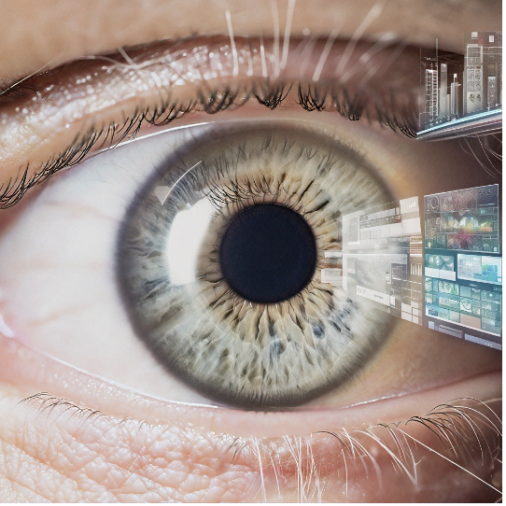

It is a Dog.
observe
visual perception
cognitive reactions
Human vision schematic flow

Slide 44
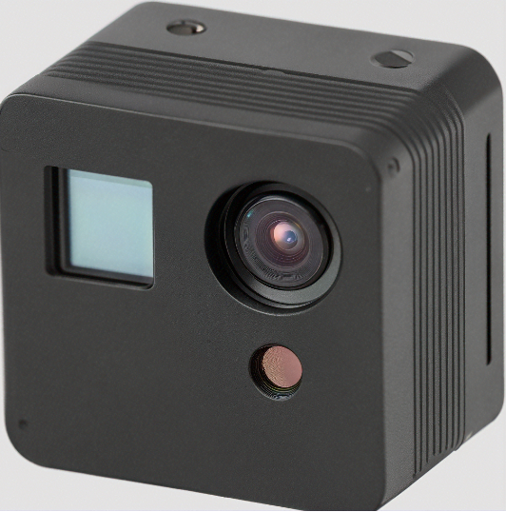
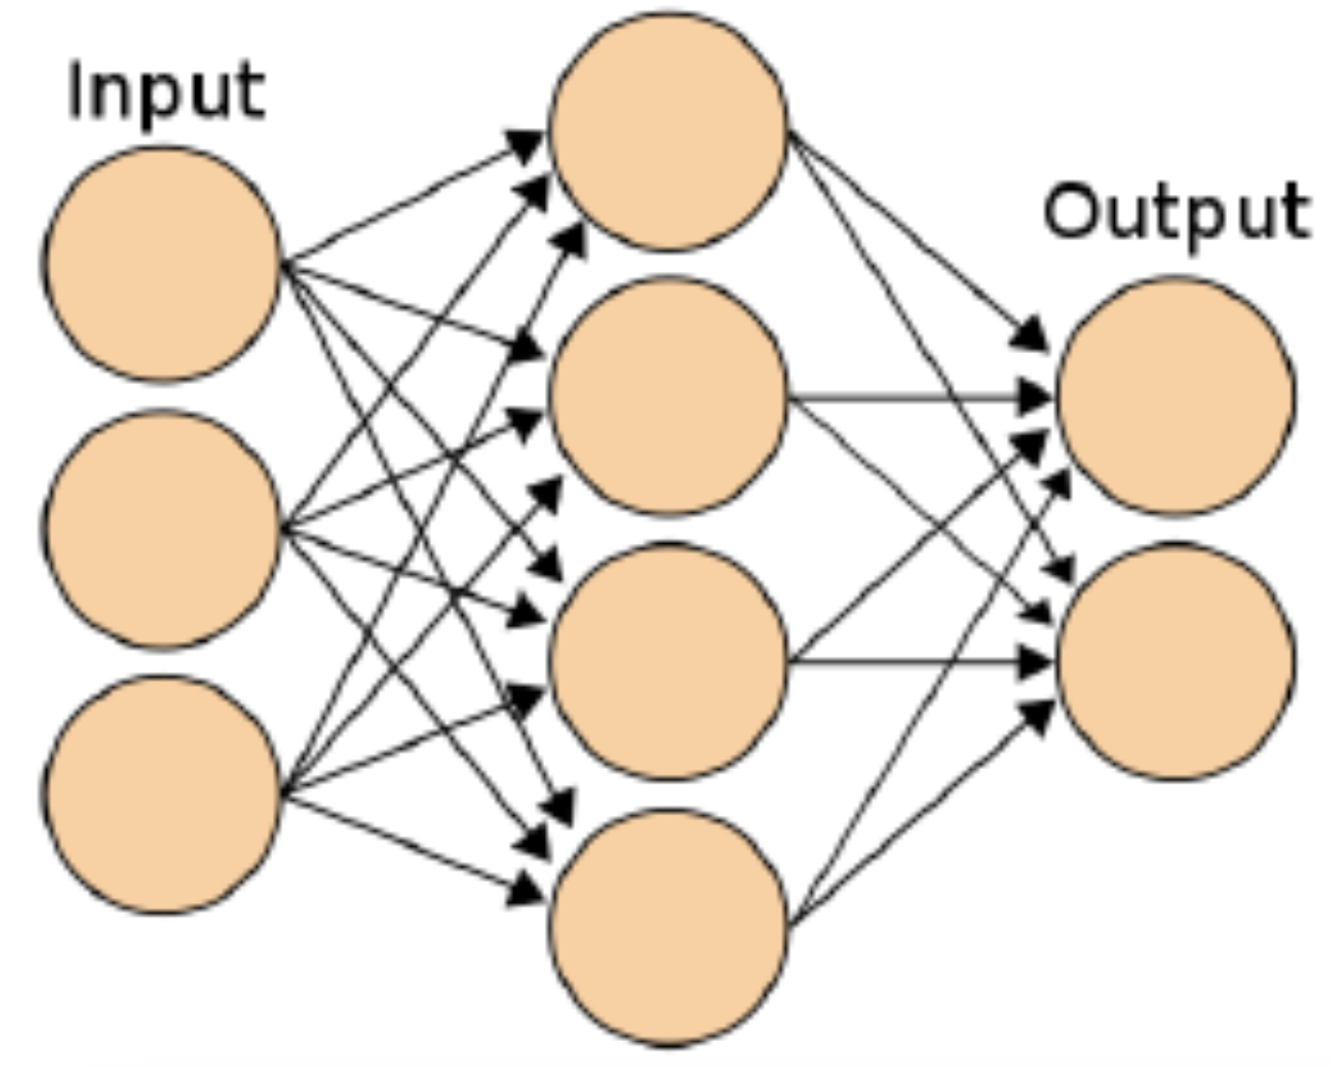
It is a Dog.
Capture
Feeding neural network
cognitive outcome
Artificial Intelligence (AI) Computer vision schematic flow

Slide 45
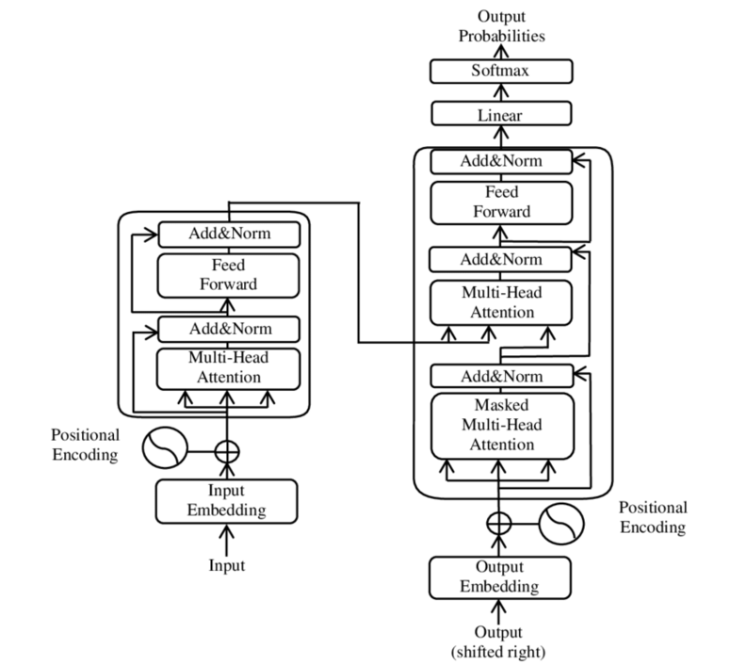

Slide 46
The
cat
chased
the
rat
in
the
kitchen
Encoder
Decoder
Inputs sequence of data
Outputs sequence of data
Transformer
El
gato
persiguió
a
la
rata
en
la
cocina
Notes:
El gato persiguió a la rata en la cocina

Slide 47
The
food
at
the
<MASK>
was
excellent
kitchen
Masked Language Model
bi-directional context
Original Prompt “The food at the restaurant was excellent.”
Encoder
Transformer
Notes:
El gato persiguió a la rata en la cocina

Slide 48
The
food
at
the
??
Causal Language Model
The
food
at
the
restaurant
??
The
food
at
the
restaurant
was
??
uni-directional context
Encoder
Original Prompt: Complete the sentences “The food at the”
Transformer
Notes:
El gato persiguió a la rata en la cocina

Slide 49
The
food
at
the
<MASK>
<MASK>
excellent
kitchen
Span Corruption
The
food
at
the
<Sentinel Token>
excellent
kitchen
Original Prompt “The food at the restaurant was excellent.”
Encoder
Transformer
Notes:
El gato persiguió a la rata en la cocina

Slide 50
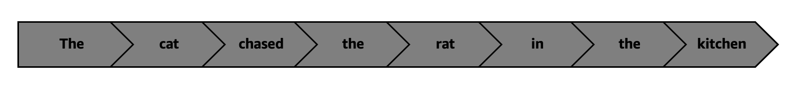
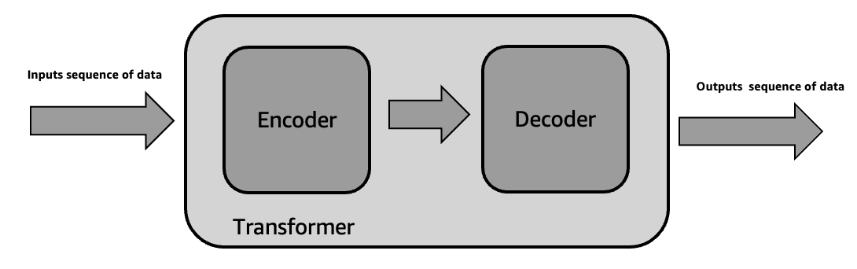
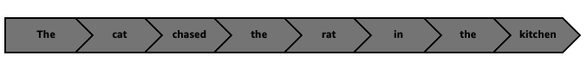

Slide 51
The
cat
chased
the
rat
in
the
kitchen
Decoder
Encoder 1
Encoder 2
Outputs sequence of data
Inputs sequence of data
Transformer
El
gato
persiguió
a
la
rata
en
la
cocina
Notes:
El gato persiguió a la rata en la cocina

Slide 52
Decoder
Multi head attention
Feedforward network
Multi head attention
Feedforward network
Outputs sequence of data
Inputs sequence of data
Encoder 1
Encoder 2
Encoder stack
Transformer
Notes:
El gato persiguió a la rata en la cocina

Slide 53
Decoder
Input Embedding
Position Encoding
Multi head attention
Feedforward network
Multi head attention
Feedforward network
Outputs sequence of data
Inputs sequence of data
Encoder 1
Encoder 2
Encoder stack
Transformer
Notes:
El gato persiguió a la rata en la cocina

Slide 54
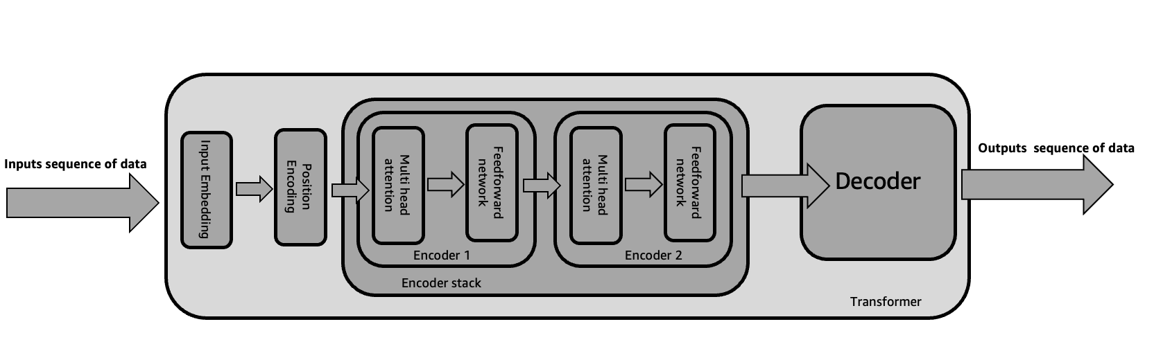
Residual connections
Input Embedding
Position Encoding
Multi head attention
Feedforward network
Multi head attention
Feedforward network
Features
Inputs sequence of data
Encoder 1
Encoder 2
Transformer
Encoder stack
Notes:
El gato persiguió a la rata en la cocina

Slide 55
Residual connections
Input Embedding
Position Encoding
Multi head attention
Feedforward network
Multi head attention
Feedforward network
Features
Inputs sequence of data
Encoder 1
Encoder 2
Encoder stack
Position Encoding
Outputs sequence of data
Input Embedding
Decoder 1
Decoder 2
Encoder stack
Transformer
Notes:
El gato persiguió a la rata en la cocina

Slide 56
Residual connections
Input Embedding
Position Encoding
Multi head attention
Feedforward network
Multi head attention
Feedforward network
Features
Inputs sequence of data
Encoder 1
Encoder 2
Encoder stack
Masked Multi-Head Attention
Multi head attention
Feedforward network
Masked Multi-Head Attention
Multi head attention
Feedforward network
Outputs sequence of data
Position Encoding
Input Embedding
Decoder 1
Decoder 2
Encoder stack
Transformer
Notes:
El gato persiguió a la rata en la cocina

Slide 57
Artificial Intelligence
Machine Learning
Deep Learning
Generative AI
Data Science
Enterprise Data
&
Metadata
Big Data

Slide 58










Generative AI Stack
APPLICATIONS THAT LEVERAGE LLMs AND OTHER FMs
Amazon Q
Amazon Q in
Amazon QuickSight
Amazon Q in
Amazon Connect
Amazon CodeWhisperer
TOOLS TO BUILD WITH LLMs AND OTHER FMs
Amazon Bedrock
Guardrails
Agents
Customization Capabilities
INFRASTRUCTURE FOR FM TRAINING AND INFERENCE
GPUs
Trainium
Inferentia
SageMaker
UltraClusters
EFA
EC2 Capacity Blocks
Nitro
Neuron

Slide 59
Application that leverage LLM’s and other FMs
Tools to build with LLM’s and other FMs
Infrastructure for FM Training & Inferences
Notes:
Top layer of the stack: Application that leverage LLM’s and other FMs
Middle layer of the stack: Tools to build with LLM’s and other FMs
Bottom layer of the stack: Infrastructure for FM Training & Inferences

Slide 60
Infrastructure for FM Training & Inferences
GPUs
Trainium
Inferentia
SageMaker
Ultraclusters
EFA
EC2 Capacity Blocks
Nitro
Neuron

Slide 61
Tools to build with LLM’s and other FMs
Amazon Bedrock
Amazon Bedrock advanced features
Application that leverage LLM’s and other FMs
Amazon CodeWhisperer
Amazon Q

Slide 62
